Slide 1
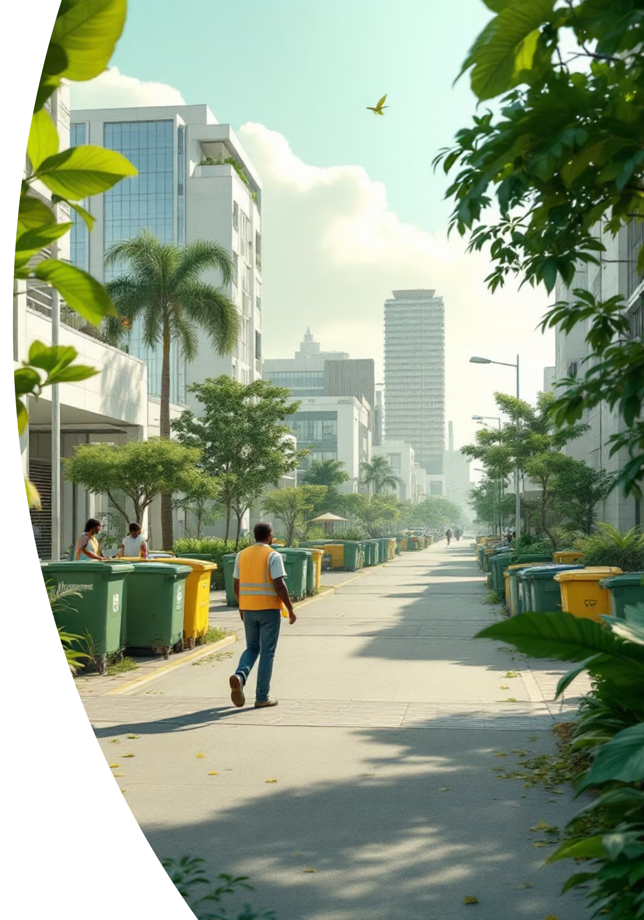
GreenBin: Digital Waste Management Platform
Transforming waste management in Ghana through innovative digital solutions for sustainable urban environments

Slide 2

Background: Ghana's Waste Challenge
Access to efficient waste management services is a vital aspect of maintaining public health and environmental sustainability. Globally, the volume of solid waste generated is increasing as a result of population density, economic growth, urbanization, and industrialization (UNEP, 2009) and Ghana too has it shared of contribution to this waste generation. Most of the concern for waste management in Ghana is with the urban areas than the rural areas. Urban areas in Ghana produce a variety of waste. The predominant wastes being domestic solid waste, industrial waste and construction waste. (COMMISSION, n.d.). Ghana generates approximately 12,710 tonnes of solid waste daily. (Tagoe, 2025).
Referneces
Tagoe, B. B. (2025). ghScientific. Retrieved from ghscientific.com: https://ghscientific.com/ghanas-waste-management-crisis-a-growing-threat-to-public-health-and-environment
UNEP. (2009). Converting waste plastics into a resources—Assessment Guidelines. Assess Guidel.
COMMISSION, T. U. (n.d.). sustainabledevelopment. Retrieved from sustainabledevelopment

Slide 3
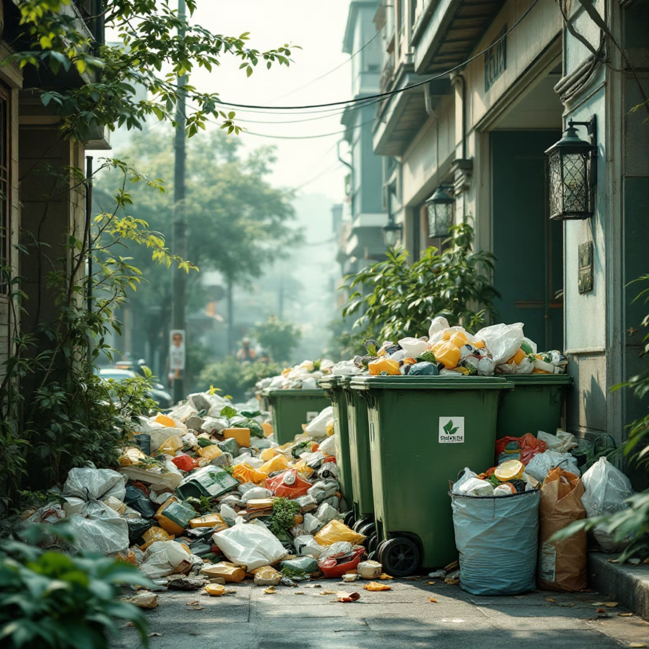
Problem Statement
Absence of reminders for waste collection, leading to missed pickups.
Inability of residents to access information on proper waste disposal practices.
Poor inventory management of waste collection resources.
Difficulty in tracking waste collection requests

Slide 4
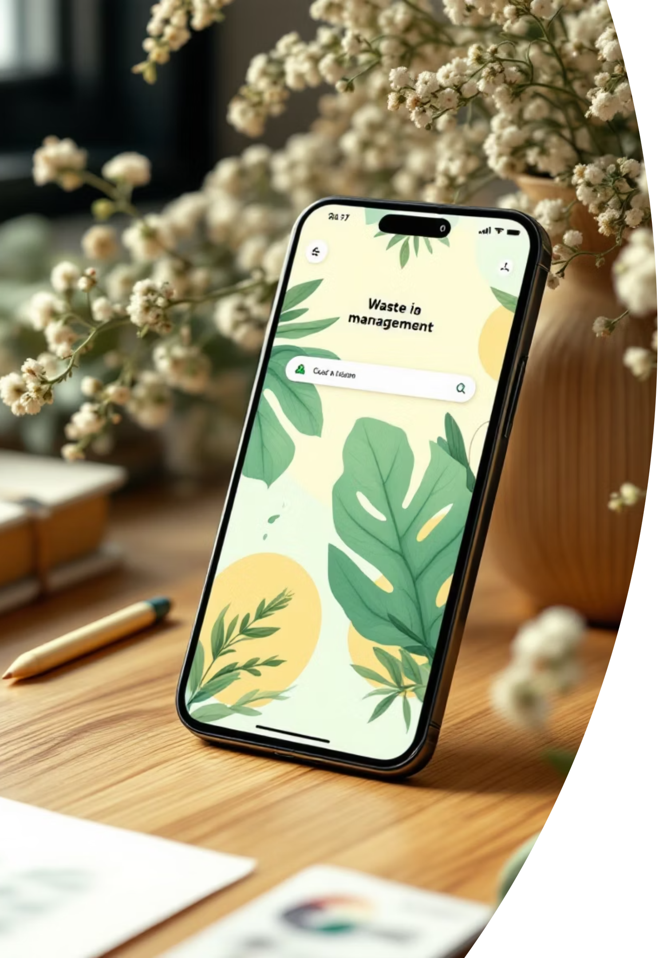
Objectives
To develop a comprehensive digital waste management platform that streamlines the process of scheduling, tracking, and managing waste collection for both residents and waste management authorities.
Specific Objectives
To design and implement a database for storing waste collection schedules, resident information, and waste management data.
To develop a webapp application that allows waste management authorities to manage collection routes, schedules, and personnel, which is accessible for all devices across the country

Slide 5
Related Systems

Slide 6
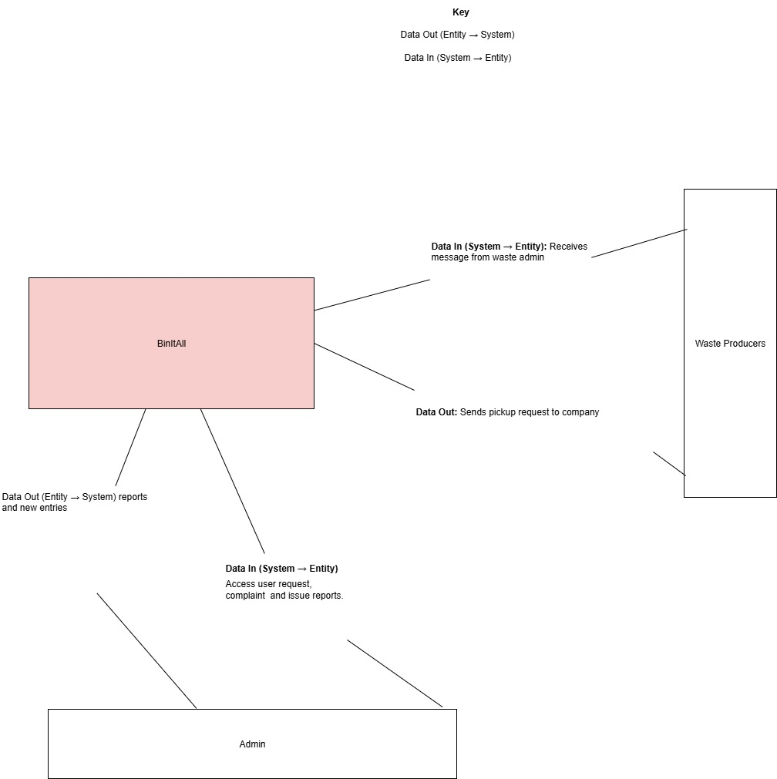

Slide 7
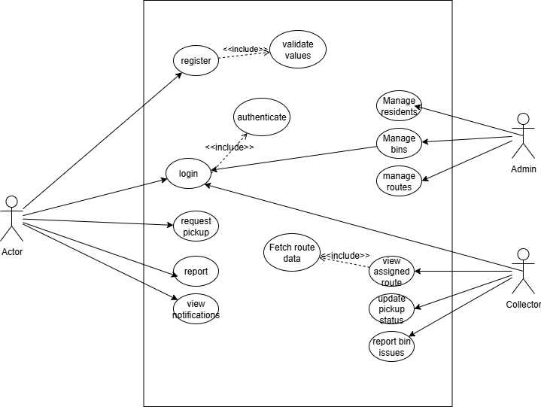

Slide 8
Methodology
Agile Method: The following steps were taken using the agile scrum method
Requirements Gathering
Design
Implentation and Testing
During this phase, the team engaged residents, municipal authorities, and waste collectors to understand the pain points in waste collection and define both functional and non-functional requirements
The system was developed iteratively in sprints, with continuous testing and feedback after each feature release.
Activities
Sprint 1: Built the resident registration and login module.
Sprint 2: Developed waste request creation and tracking functions.
Sprint 3: Added collection route assignment and admin dashboard analytics.
Sprint 4: Integrated feedback and notification modules.
The design stage focused on creating a user-centered system architecture and interface prototypes to visualize GreenBin’s functionality.
Deployment
Maintenance
The system was released in phases, starting with a pilot in selected neighborhoods before full rollout.
Post-deployment, continuous updates and optimizations were made to ensure system performance and user satisfaction.

Slide 9
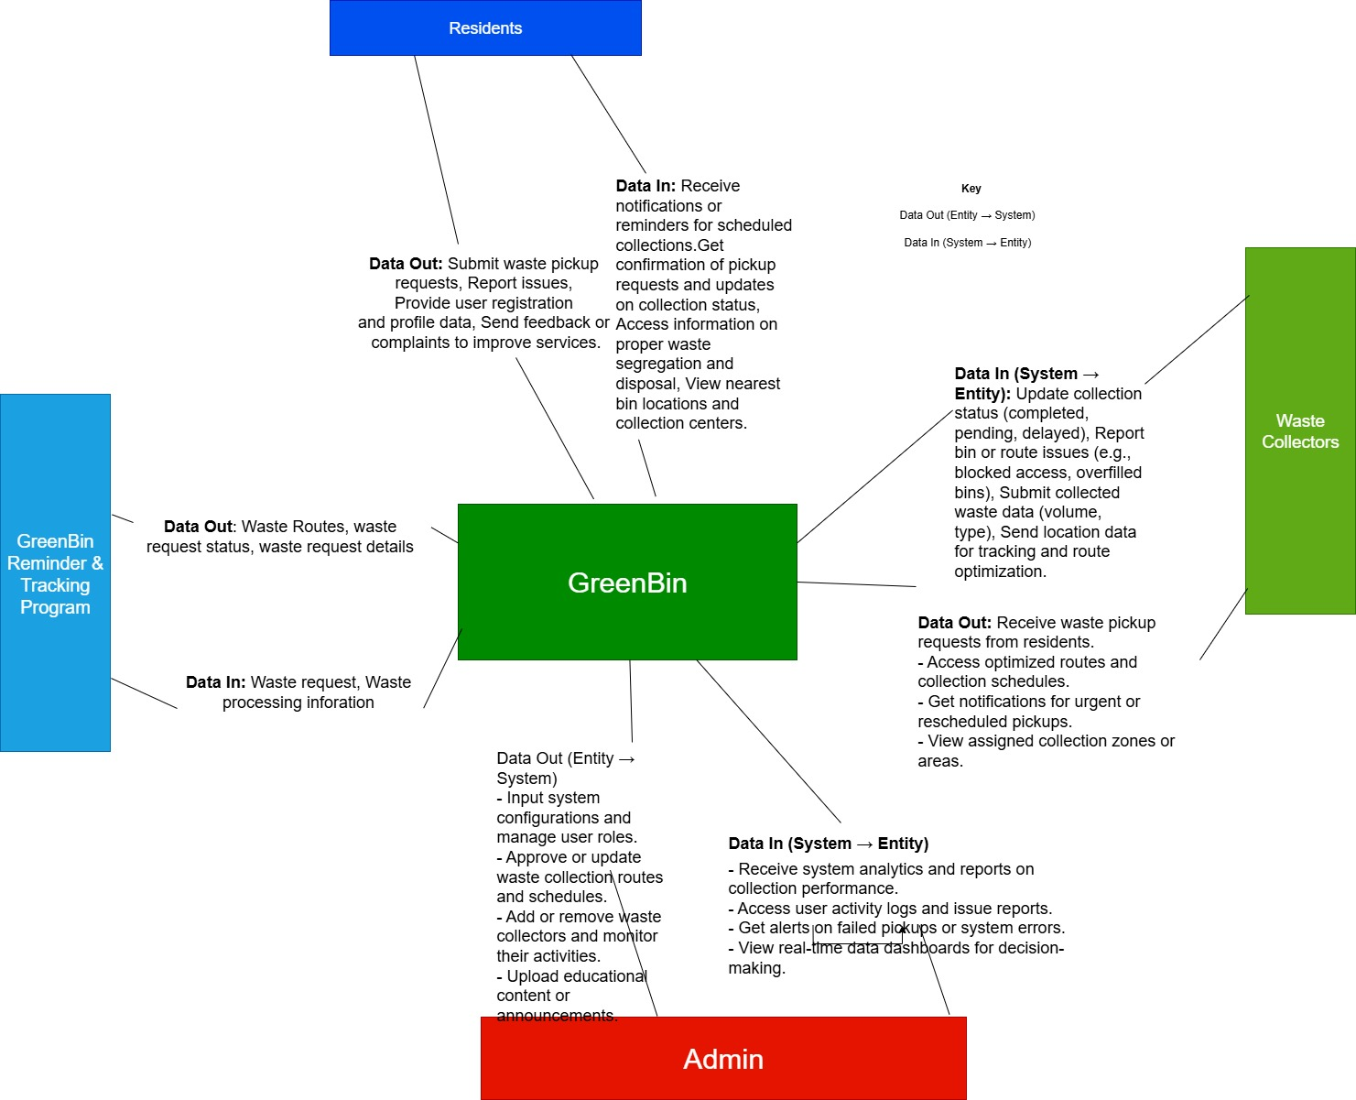

Slide 10
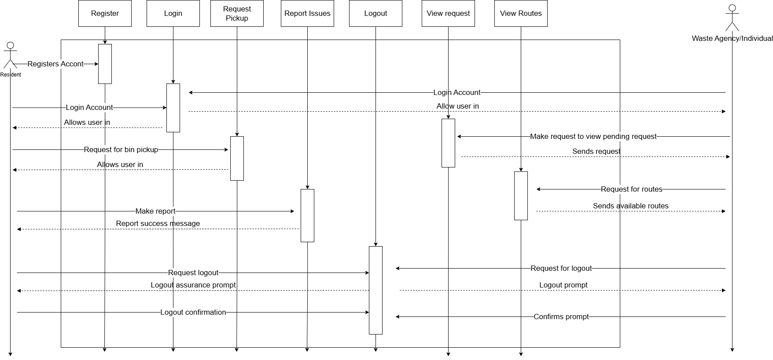

Slide 11
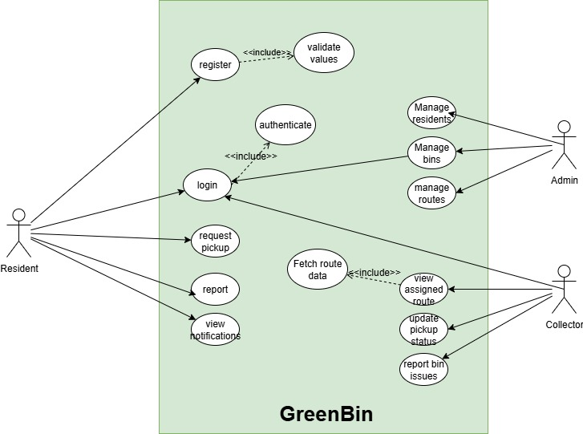

Slide 12
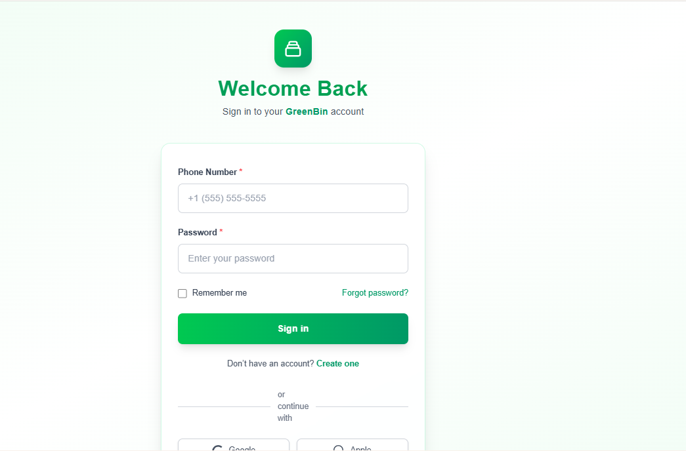
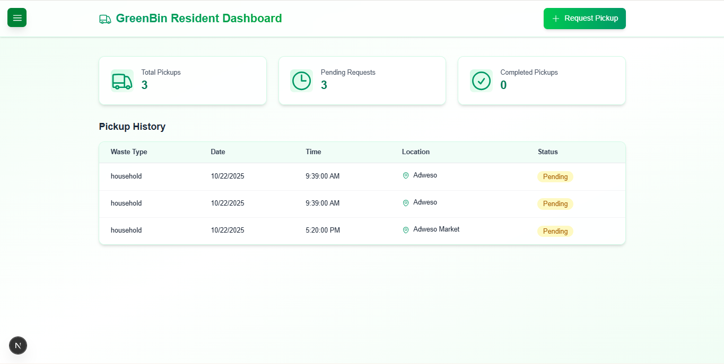
Testing
Unit Testing, Integrated Testing, System Testing
Login
Dashboard

Slide 13
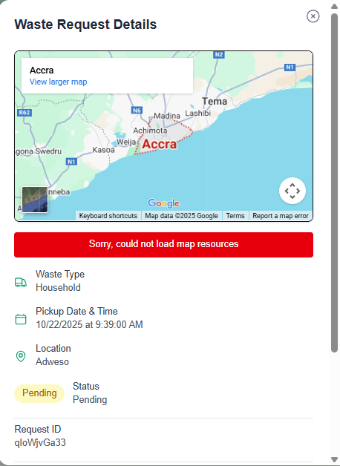
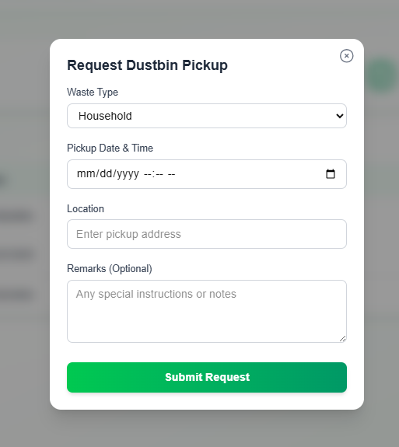
Book Request
Waste Request Details

Slide 14
Results and Analysis

Slide 15
Analysis:
The development of GreenBin has the potential to significantly improve waste management in Ghana by:
Enhancing efficiency: Automating waste collection scheduling and tracking reduces administrative burdens and minimizes the likelihood of missed collections.
- Promoting sustainability: Educating residents on proper waste disposal practices and encouraging responsible waste management behaviors contributes to a cleaner and healthier environment.-
Improving community engagement: The platform provides a channel for residents to report issues and interact with waste management authorities, fostering a sense of community and cooperation.
Achievement of Objectives:
A user-friendly web application was developed, allowing residents to schedule waste collections, report issues, and interact with waste management authorities.
A database was designed and implemented to store waste collection schedules, resident information, and waste management data.
A notification system was integrated, sending reminders for waste collection schedules and special collection events.
Features for tracking waste collection requests, monitoring waste levels, and providing educational resources on proper waste disposal practices were implemented.

Slide 16


Conclusions and Recommendations
Proven Solution
Scalable Framework
Equity Focus
GreenBin successfully addresses critical gaps in Ghana's waste management infrastructure through digital innovation
Platform architecture supports expansion to additional cities and regions across the country
Technology bridges service disparities, ensuring underserved communities receive adequate waste collection
Moving Forward
Expand pilot program to cover entire Koforidua municipality and adjacent districts
Integrate with existing municipal systems for seamless data exchange and coordination
Develop partnerships with private waste collectors to broaden service network
Launch public awareness campaigns to drive adoption and promote proper waste disposal
Establish continuous improvement cycles using system analytics and user feedback
Explore integration of IoT sensors in waste bins for real-time fill-level monitoring
References
UNEP (2009). Converting waste plastics into a resource—Assessment Guidelines.
Prof. Martin Oteng_Ababio, I. (2024). Managing solid waste for a sustainable. Accra.
Tagoe, B. B. (2025). Ghana's waste management crisis: A growing threat to public health and environment. ghScientific.
The UN Commission. Sustainable Development: Waste Management in Ghana.

